Slide 1
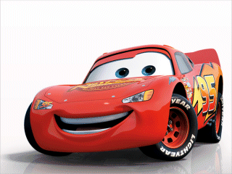
Driverless Cars The Summary
Notes:
We will take into consideration the other two groups for self driving cars

Slide 2
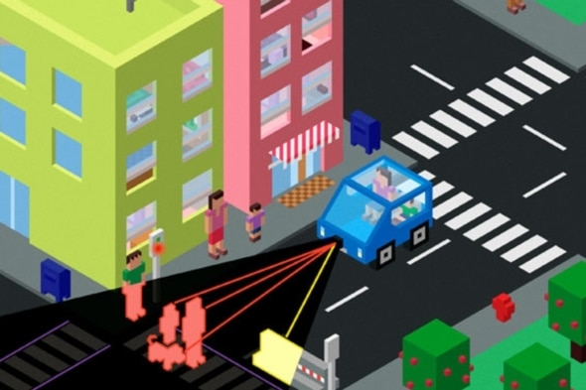
The Problem (A variation of the Trolley Problem)
Scenario B
The car swerves to try and avoid hitting the pedestrian.
Scenario A:
The car continues on its path, hitting the pedestrian.
Notes:
How should a driverless car react if a pedestrian steps out in front of it giving it no time to stop?

Slide 3
Assumptions
We are assuming the pedestrian that is jumping out in front of the car is doing so illegally.
The self driving car is driving legally.
The self driving car contains all modern safety devices and features(e.g. airbags, crumple zones, seatbelts, ABS, ESC).
In all scenarios the car is always attempting to slow down.
The car does not have a manual override for the passenger/driver.

Slide 4
Reasons for Hitting the pedestrian
Swerving can result in a collision with vehicles in other lanes, parked vehicles, other pedestrians or objects on the side of the road.
This could possibly be fatal to the passengers in the car or pedestrians on the pavement.
Why should people on the side of the road carrying out legal actions be in danger because of someone else committing illegal actions.
Customers are more likely to purchase a self-driving car if it is designed to prioritise its passengers’ safety.
At high speeds, swerving may still result in hitting the pedestrian, but with less control.

Slide 5
Additional reasons to hit the pedestrian
The AA say the following about how to deal with a deer running in front of your car:
Don’t over-react or swerve excessively. It is safer to continue on your normal track rather than swerving or braking too hard to try and avoid the deer.
Bear in mind that if you do swerve and miss a deer (or any other animal) it will be very hard to prove that the deer ever existed.
We believe that you can look at a human running out in front of your car from a similar perspective. Would an insurance company believe that the pedestrian was ever actually there when you try and make a claim?

Slide 6
Reasons for Swerving
Self- driving cars will have a lot of sensors built in.
Human error. The car isn’t likely to make the same mistakes a human might make in this situation.
Cars have a number of safety features built in such as crumple zones, airbags and seatbelts.

Slide 7
Additional reasons to swerve
If the car swerves the pedestrians have more time to move out of the way as it is taking a more indirect route.
Business Perspective - Will people buy a car that does not seem to react when someone jumps out in-front of it?

Slide 8
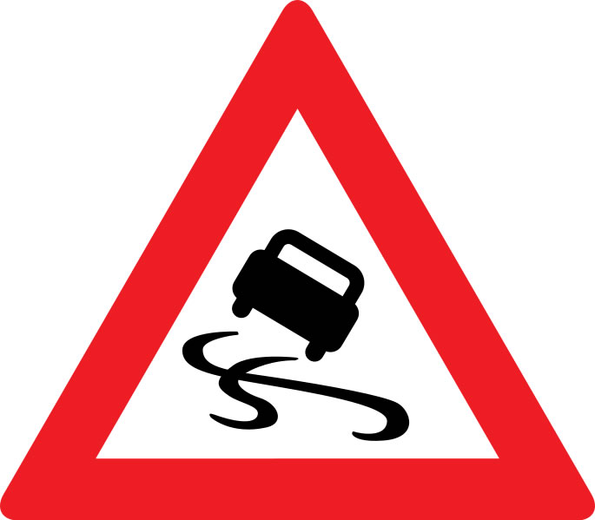
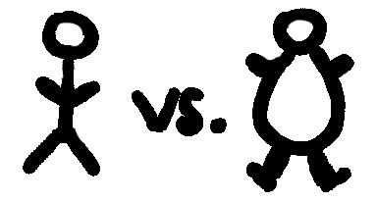
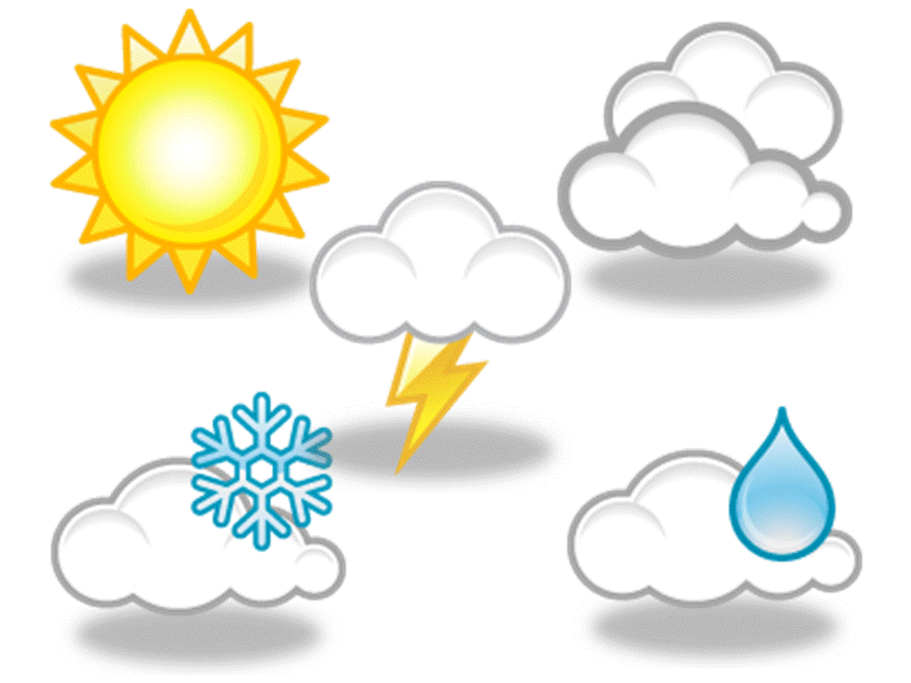
Variables When driving, the following variables must be taken into consideration:
Current driving speed
Type of road
Surroundings
Passenger weight
Pedestrian location on road
Pedestrian weight
Weather
Road conditions
Visibility
Traffic

Slide 9
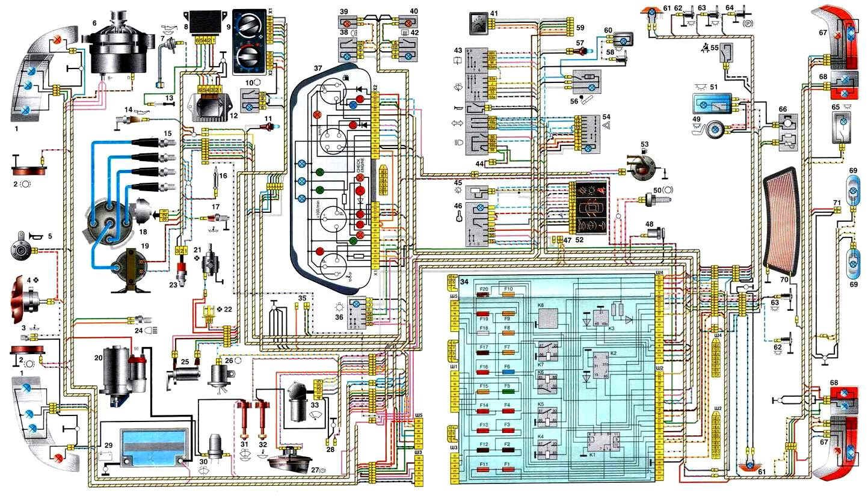
Vehicle Sensors
Lidar, Laser Range finder for long distance approx 200m.
Camera that uses image processing for close range.
Bumper mounted radar for monitor cars infront and behind .
Altimeters, gyros, magnetometers, accelerometer.
Running a pre-mapped route.

Slide 10
Has the trolley problem ever actually occurred?
“The main thing to keep in mind is that we have yet to encounter one of these problems”.
“If we did see a scenario like that, usually that would mean you made a mistake a couple of seconds earlier”.
“It takes some of the intellectual intrigue out of the problem, but the answer is almost always ‘slam on the brakes”.
- Andrew Chatham, Principal engineer at Google.

Slide 11
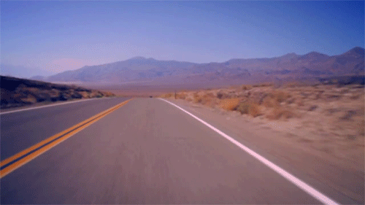
Compromise
If, based on the given variables, it is deemed safe to swerve, the car should swerve. In the case that it isn’t safe, then the car should plow into the pedestrian.
Swerve Plow Into

Slide 12
Conclusion
Swerve if safe to do so!
We feel that this is the best approach because the question of what to do depends very much on the context of the situation.
Ideally the car should be able to make a decision at the time this problem occurs, and it should make the decision that reduces the chance of injury and deaths.

Slide 13
References
Self-Driving car’s sensors- https://www.national.co.uk/tech-powers-google-car/
Andrew Chatman Interview -
https://www.theguardian.com/technology/2016/aug/22/self-driving-cars-moral-dilemmas
The AA Top tips for avoiding deer on the road-
https://www.theaa.com/driving-advice/safety/deer-collisions

Slide 14
http://www.accuweather.com/en/weather-news/self-driving-cars-will-they-be-safe-during-bad-weathr/60524998
Fight or flight response - makes you act less rationally
https://www.nottingham.ac.uk/counselling/documents/podacst-fight-or-flight-response.pdf
94% of road accidents are caused by human error.
https://crashstats.nhtsa.dot.gov/Api/Public/ViewPublication/812115

